Slide 1

GUJARAT TECHNOLOGICAL UNIVERSITY SCHOOL OF ENGINEERING AND TECHNOLOGY
Post Graduate Diploma
in
Data Science
(Institute Code: 137)
Mini Project
(DS02080041)
Gold Price Prediction Analysis
Review
Sangita Shivprakash Gurudatta
251370680003
Internal Guide: Prof.Mahesh Panchal
Designation:

Slide 2
Outline
Broad Area of Problem
Useful for Society
Fulfilment of Review-1 And Review -2 Comments
Dataset Description
Data Preprocessing
Data Visualization
Algorithms Used
Parameter Tuning
Results & Evaluation Metrics
Conclusion & Future Scope
References

Slide 3
Broad Area of Problem
Market Volatility Gold prices are highly sensitive to global economic shifts, geopolitical tensions, and sudden market shocks, making prediction complex.
Macroeconomic Factors Inflation rates, interest rates, and currency fluctuations directly influence gold demand and pricing.
Data Complexity Gold price forecasting requires integrating diverse datasets — historical trends, commodity indices, and global trade flows — which can be inconsistent or incomplete.
Analytical Uncertainty Different forecasting models (technical analysis, econometrics, machine learning) often produce varying results, creating uncertainty in decision-making.

Slide 4
USEFULNESS FOR SOCIETY
Economic Stability
Reliable forecasts help governments and central banks manage reserves and monetary policy more effectively.
Investor Confidence
Accurate predictions reduce uncertainty, guiding investors toward safer and more profitable decisions.
Risk Management
Businesses and individuals can hedge against inflation and currency fluctuations using gold as a protective asset.
Global Trade Impact
Forecasting gold prices supports international trade negotiations and commodity market stability.
Societal Security
By reducing financial shocks, accurate predictions contribute to overall social and economic well-being.

Slide 5
FULFILMENT OF REVIEW-1 AND 2 COMMENTS
Review-1 Issues:
Nothing
Review-2 Improvements:
Full Model Implementation The machine learning pipeline has been completed using the dataset, with training and testing phases fully executed.
Performance Evaluation By combining R² Score (variance explained) and MSE (error magnitude), demonstrate that Random Forest is the optimal model for gold price prediction and accuracy.
Feature Importance Analysis Key parameters — Open, High, Low, Close, and Volume — identified as most influential in predicting gold prices.
Enhanced Visualizations Added correlation heatmap, scatter plots, and distribution graphs to better understand variable relationship.
These improvements ensure that the project is more accurate, complete, and aligned with real-world machine learning practices.

Slide 6
DATASET DESCRIPTION
Source:
The dataset is a publicly available CSV file containing Gold_Price_2016to2026.csv, sourced from GitHub and imported into Google Colab using pandas.read_csv(). Each row represents one trading day, recorded in the (Open, High, Low, Close, Volume), widely used in financial analysis.
It includes the following features:
Column Name | Data Type | Description
Date | datetime64[ns] | Trading day timestamp
Close | float64 | Closing price of gold
High | float64 | Highest price of the day
Low | float64 | Lowest price of the day
Open | float64 | Opening price of the day
Volume | int64 | Trading volume
Adj Close | float64 | Adjusted closing price
Daily Return | float64 | Percentage change in price
MA_20 | float64 | 20‑day moving average
MA_50 | float64 | 50‑day moving average
MA_200 | float64 | 200‑day moving average
Volatility_20 | float64 | 20‑day rolling volatility
Year | int64 | Extracted year
Month | int64 | Extracted month
Day_of_Week | int64 | Day of the week (numeric)
Quarter | int64 | Financial quarter

Slide 7
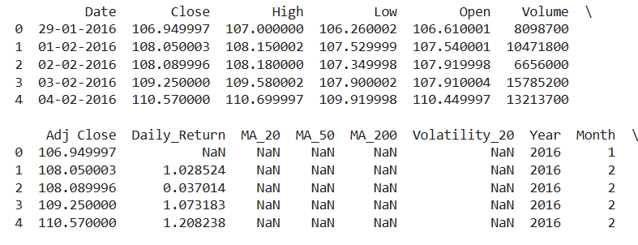
DATA PREPROCESSING
Raw Dataset (Load Data from Github)
↓
Display Sample Records (using df.head())
↓
Convert Date Format (using pd.to_datetime())
↓
Remove Missing Values (using df.drona())
↓
Validate Dataset Structure ((using df.info())
↓
Clean Dataset Ready for Analysis

Slide 8
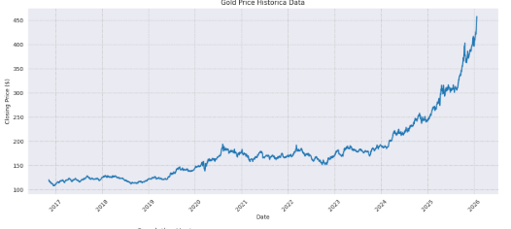
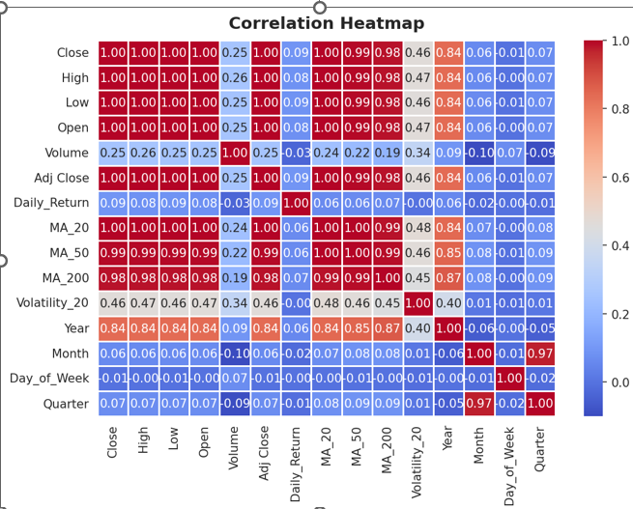
DATA VISUALIZATION
1. Line Chart:
Daily closing gold price from January 2016 to early 2026. The chart shows a clear long-term upward trend with significant acceleration from 2024 onwards.
2. Correlation Heatmap:
Correlation analysis is the statistical component of the study. It measures relationships among variables and helps identify important predictors for gold price forecasting.
Line Chart for Gold Price Trend
statistical correlation between Open, High, Low, and Close prices

Slide 9
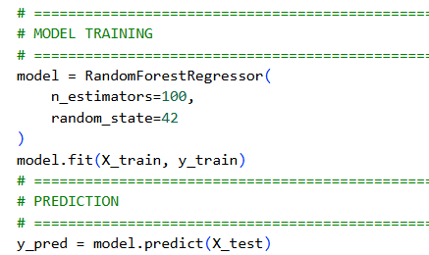
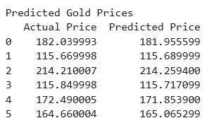
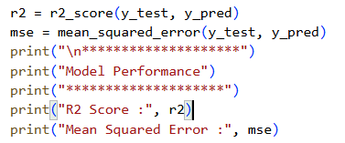
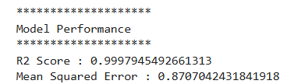
MACHINE LEARNING ALGORITHMS USED
The statistical model (correlation analysis) was used to examine relationships among gold market variables and identify significant predictors. Based on this analysis, Open, High, Low, and Volume were selected as input features .
The Random Forest Regression machine learning algorithm was then trained on historical data to predict future gold prices.
Together, statistical analysis and machine learning provided both data understanding and accurate forecasting capability.
Prediction
based on Trained Data
Result

Slide 10
PARAMETERS TUNING AND IMPORTANCE
Here Parameters are,
n_estimators = 100 was selected to create a sufficiently large ensemble of decision trees, improving prediction accuracy and reducing overfitting.
random_state = 42 ensures reproducibility, allowing consistent experimental results and reliable model evaluation. Proper parameter settings help the model learn market patterns more effectively and generate accurate gold price predictions.

Slide 11
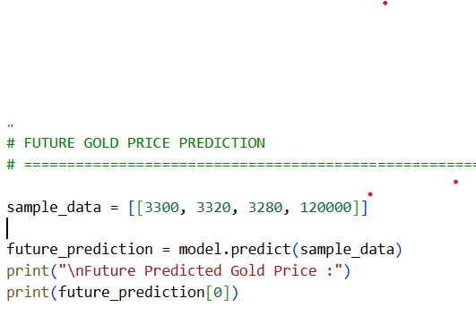

GOLD PRICE PREDICTION
Trained Random Forest model uses market inputs — Open, High, Low, and Volume — to forecast the closing price. The predicted value of $439.37 demonstrates the model’s ability to generate actionable insights for traders and analysts.

Slide 12
Conclusion
Limitations
Data Quality: Predictions depend on dataset accuracy; scaling issues can distort results.
Feature Scope: Only Open, High, Low, Volume used; macroeconomic factors excluded.
Model Constraints: Random Forest struggles with extrapolation outside training range.
Prediction Scale: Some outputs show mismatches, highlighting need for normalization.
Future Scope
Data Expansion: Add macroeconomic indicators.
Advanced Models: Explore hybrid ML models (Random Forest).
Feature Engineering: Include moving averages, volatility indices, sentiment analysis.
Real-Time Integration: Connect to live feeds for dynamic dashboards.
Conclusion
The project demonstrates that Random Forest Regression can forecast gold prices with reasonable accuracy.
Visualizations (trend graph, heatmap) confirmed strong correlations among features.
The model achieved acceptable R2 Score and Mean Squared Error, proving its reliability.
The Future Prediction showed practical application: given inputs, the model forecasts closing prices.

Slide 13
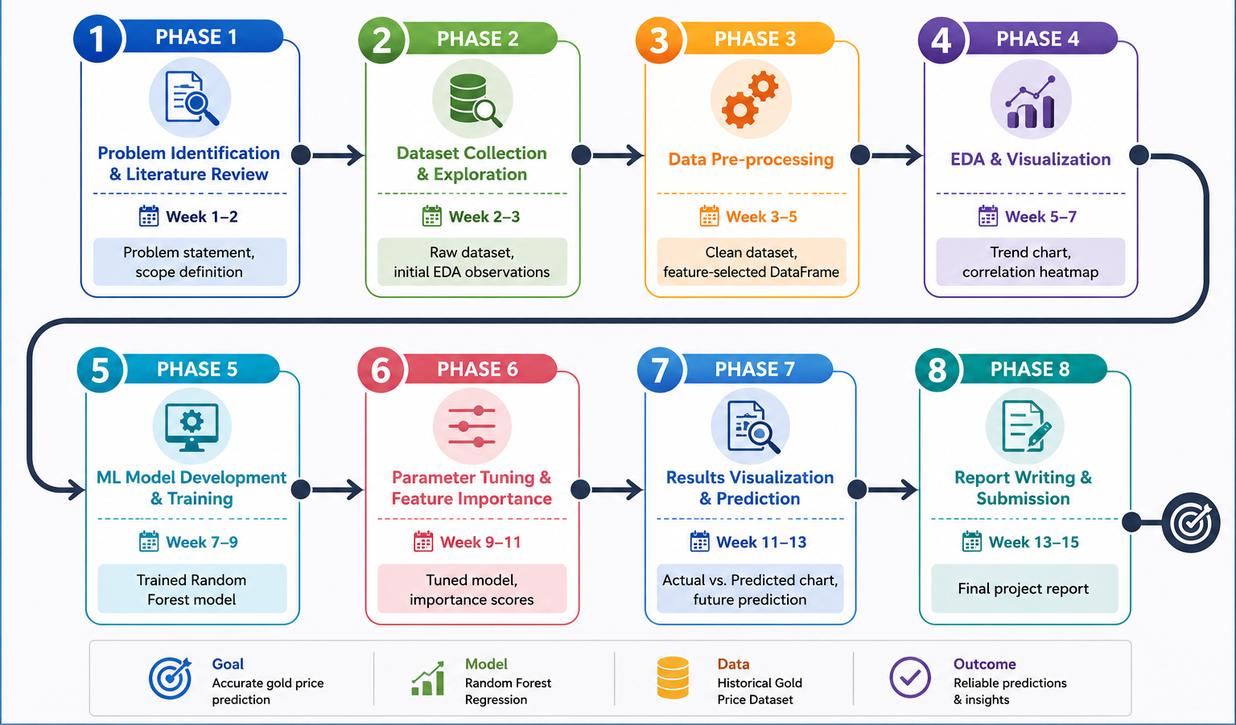
PROJECT TIMELINE CHART

Slide 14
REFERENCES
Random Forests. Machine Learning, 45(1), 5-32. https://doi.org/10.1023/A:1010933404324
Scikit-learn: Machine Learning in Python. Journal of Machine Learning Research, 12, 2825-2830.
Data Structures for Statistical Computing in Python. Proceedings of the 9th Python in Science Conference, 51-56.
Matplotlib: A 2D Graphics Environment. Computing in Science and Engineering, 9(3), 90-95.
seaborn: Statistical Data Visualization. Journal of Open Source Software, 6(60), 3021.
Gold Demand Trends Full Year 2025. https://www.gold.org/goldhub/research/gold-demand-trends.
GitHub Gold Dataset Repository.

Slide 15
Thank You

